Slide 1

Customer Churn Rate Analysis and Prediction for OC&Gym Gym Clubs Using Data from 2009 to 2019
Group four members:
Yitong Liu | 01625757
Faiz Fablillah | 01525542
Mingming Zhu | 01548939
Mukund Premkumar | 01605996
Isabella Li | 01547310

Slide 2
Presentation Outline (i)
Summary
Business problem overview
Summary of Analysis Approach and hypothesis
KPIs
Results of hypothesis analysis
Forecasting
Summary of Findings
Strengths/limitations
‹#›

Slide 3
Summary
Project objective – using data from 2009 until the end of 2019 analyze customer churn for OC&CGym gym club’s membership across its entire operation.
Available Data
Customers- birth year, gender, affluence, join date, subscription type, birthdate and when they left the gym
Visitation – customerid, date/time of visit, peak/offpeak
From the provided dataset we were able to find several key insights to reduce customer churn. These actionable insights are in two forms.
Improved pricing strategy
Identification of periods of time where customers are likely to churn
Developed a forecasting tool to aid management decisions using machine learning techniques
‹#›

Slide 4

Business Problem
The gym has been expanding significantly over the last 10 years but recently slowed expansion and to boost revenue the gym has increased prices.
Increased price hike has not provided you with the required, profit/revenue increase.
Customer churn has been been very high.
‹#›
I told u - presentation outlines, summary, technologies and techniques. 2,3,4,9,11,12,13,14

Slide 5
Summary of Analysis Approach and hypothesis
Below is the high level approach that we took to analyze the data
Brainstormed potential hypothesis
Decided on hypothesis
Performed data cleaning
Performed data analysis
Evaluated hypothesis
Derived business insight
Developed machine learning model
First hypothesis was that the following attributes would be related to the customer churn rate.
Gender
Age of customer
Subscription Type of customer
How regularly a customer attended the gym
At what times (peak vs non peak) a customer attends the gym
Second hypothesis was that there would be a strong seasonal effect to the revenue. We would also expect significant changes in churn rate around the time the pricing strategy was implemented.
‹#›

Slide 6
KPIs
Churn rate - (number of customers who left during the month)/(number of customers at the start of the month). If a customer was to join and leave in the same month then we also increase the numerator and denominator by 1 i.e.. they count as a churned customer.
Standardized Revenue - Since the number of locations was constantly changing we standardized the revenue by dividing the total monthly revenue by the total number of stores that were open in that month. Here on we will refer to that as standardized revenue.
‹#›

Slide 7
Results (A)
Results for Hypothesis 1
Our first hypothesis assumed that several attributes would be related to churn. The below section explores what we found for each attribute.
‹#›

Slide 8
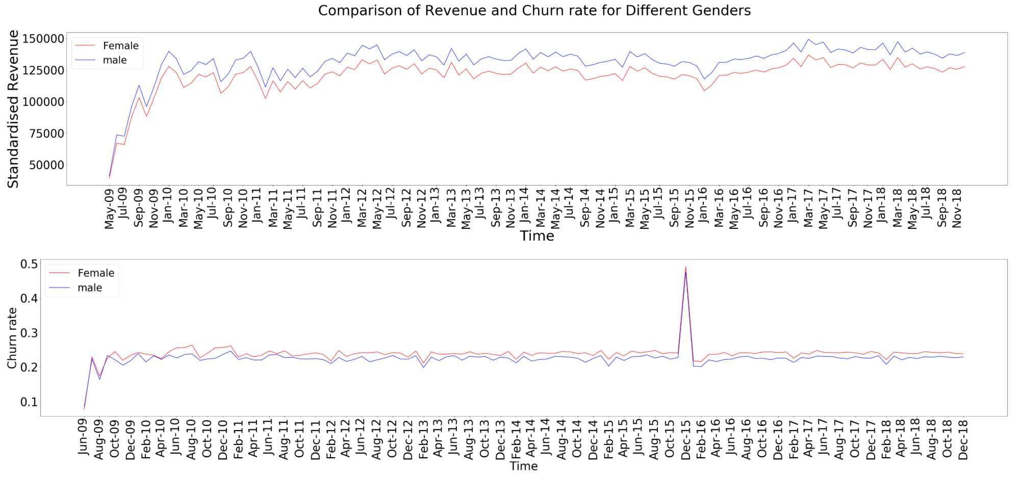
Results for Hypothesis 1 (i)
Gender –The gym should take steps to help motivate women and keep them attending.
Findings
The graph compares the revenue and churn rates between males and females. We can see that both genders follow a very similar pattern but females have consistently had a higher churn rate and have contributed less towards revenue.
Suggestions/Limitations
Offer a free diet/training plan advice as a group session for all women once a month where they get advice specific to female body types. This could help them make more progress and hence gain motivation and not drop their gym subscription.
‹#›

Slide 9
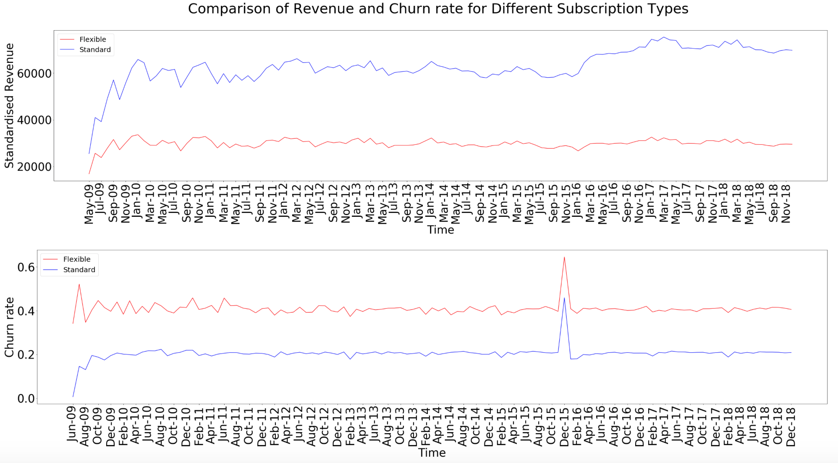
Results for Hypothesis 1 (ii)
Subscription - try and sell more standard packages
Findings
Contribution to revenue has been greater from the standard gym package as opposed to the flexible package.
Standardized revenue from the standard package took a more significant drop after the price hike but has since consistent grown and is now higher than before the price change.
The churn rate from the standard customers is significantly lower.
Suggestions/Limitations
Try and sell more standard packages, a strategy for this could be to alter the pricing strategy to waive the 6 pound joining fee for standard customers when they join.
‹#›

Slide 10
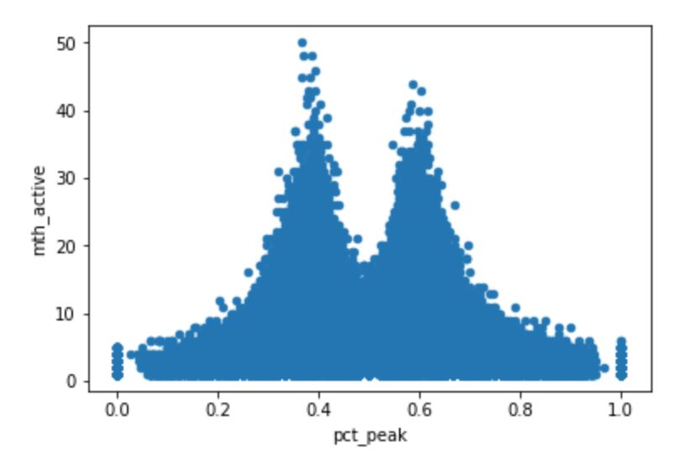
Results for Hypothesis 1 (iii)
At what times (peak vs non peak) a customer attends the gym
Findings
The graph shows the average duration of gym membership for customers who visit primarily during peak hours as opposed to during non peak hours.
bimodal distribution where people tend to stay withe the gym longer when their peak usage is approximately either 40% or 60%.
Miniscule difference in duration and hence is not a significant factor in determining churn.
‹#›

Slide 11
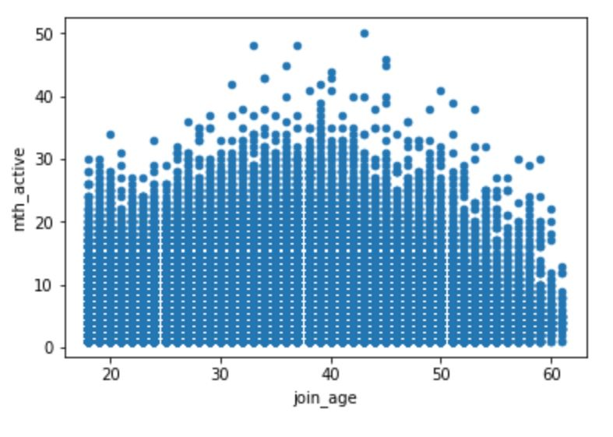
Results for Hypothesis 1 (iv)
Age at time of joining
Findings
The scatterplot here shows the distribution of the number of months people of different joining ages are active at the gym.
Clear trend that people who join at around age 38 are more likely to stay longer.
This average duration of gym membership reduces significantly as the age of the customer increases beyond 45 years.
Suggestions/Limitations
The gym should try and educate older joiners on how the can maximise their results, prevent injury and hence stay motivated.
This could be done through free workshops, induction sessions or training videos.
‹#›

Slide 12
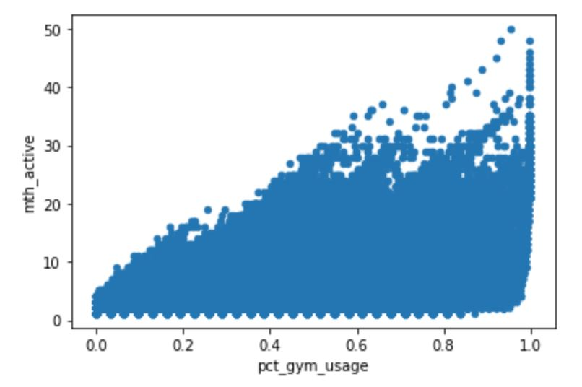
Results for Hypothesis 1 (v)
Regularly attending gym will decrease churn
Findings
The graph shows the relationship between the frequency of visits to a gym calculated as (total visits to the gym / total length of membership) and the average duration of gym memberships within the gym.
We can see a strong trend where the average durations increases as gym usage increases.
Suggestions/Limitations
To maintain a lower churn rate, gyms need to ensure that their members visit more often.
Music machines, fruit bowls, encouraging staff
‹#›

Slide 13
Results (B)
Results for Hypothesis 2
Our second hypothesis was that there would be a strong seasonal effect to the revenue and churn rate. Additionally revenue and churn rate would be negatively impacted by the price increase in 2016.
‹#›

Slide 14
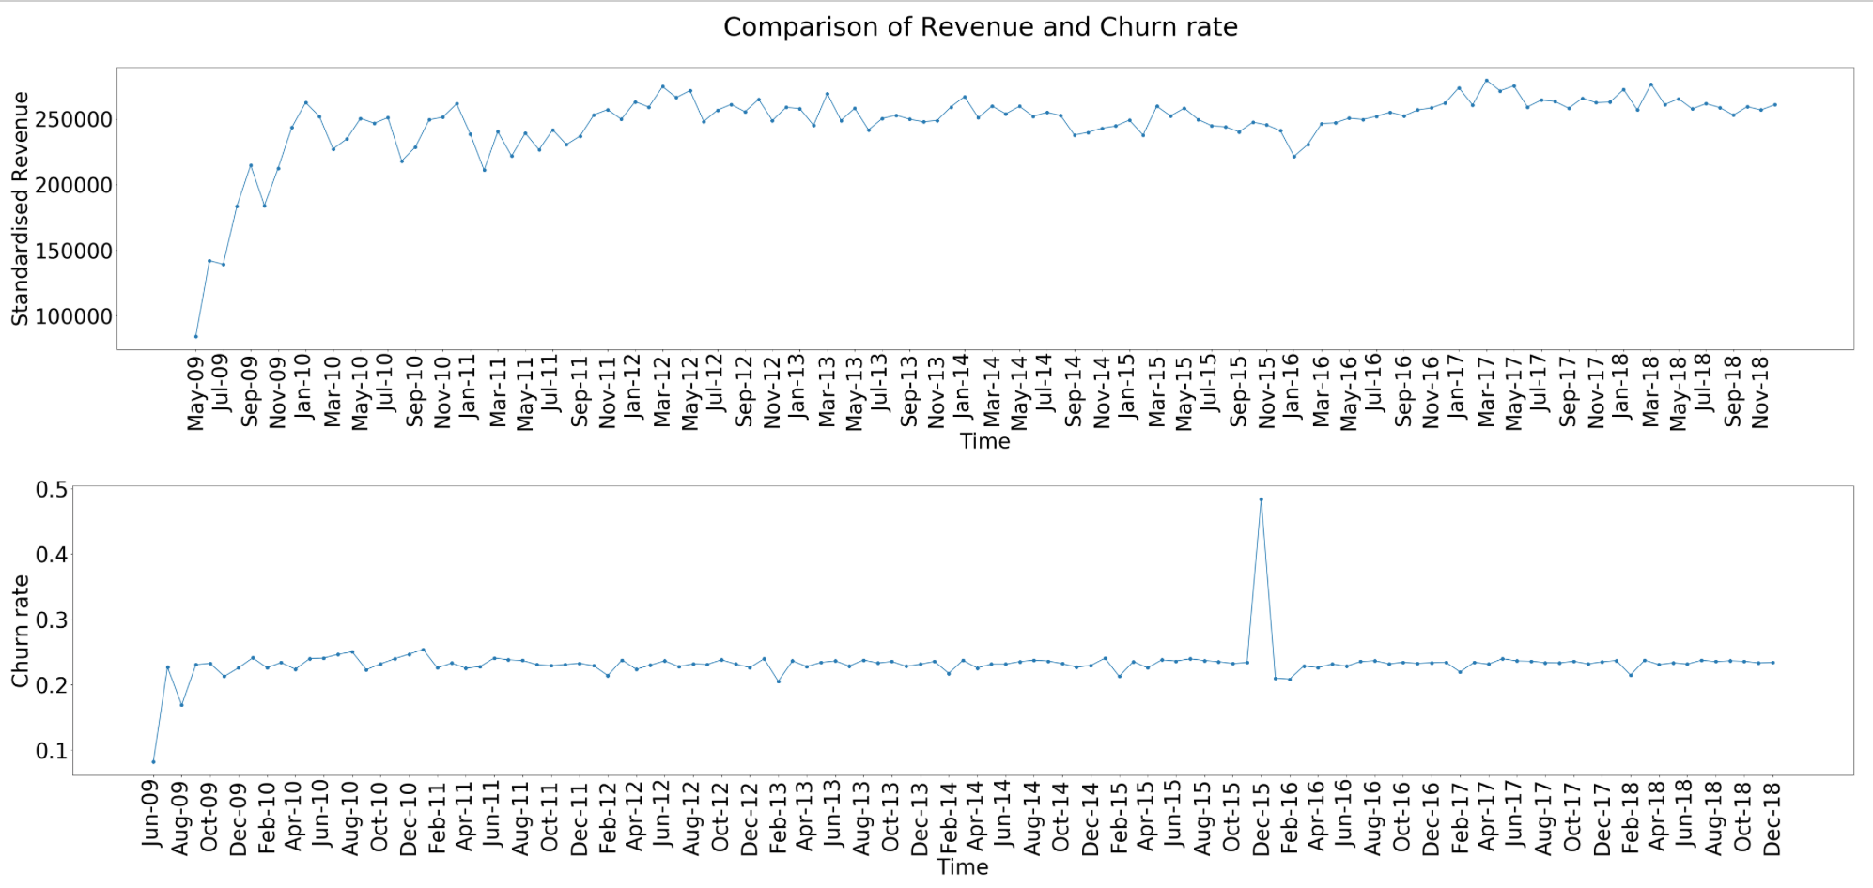
Results for Hypothesis 2 (i)
Seasonal effect shows revenue drop in February
Findings
The graph shows the change in revenue and churn rate over time for all customers.
There is a huge upward spike in churn rate right before Jan 2016,
Significant drop in standardised revenue right after the spike.
However, churn and revenue return to original amounts price change. Although the price hike impacted both churn and revenue, neither of them were impacted long term.
looking at the seasonal impacts of the data, we can see that from about 2014 onwards, there is a significant decrease in revenue each year during February. Likely because people often take on new year resolutions or get given gym memberships as Christmas gifts but often give up soon.
Suggestions/Limitations
We suggest offering free diet/training information sessions during January in order to educate people so they see results from their training and choose to continue exercising.
‹#›

Slide 15
Results (C)
Additional Findings
While exploring the data we discovered additional findings which were not a part of the original hypothesis..
‹#›

Slide 16
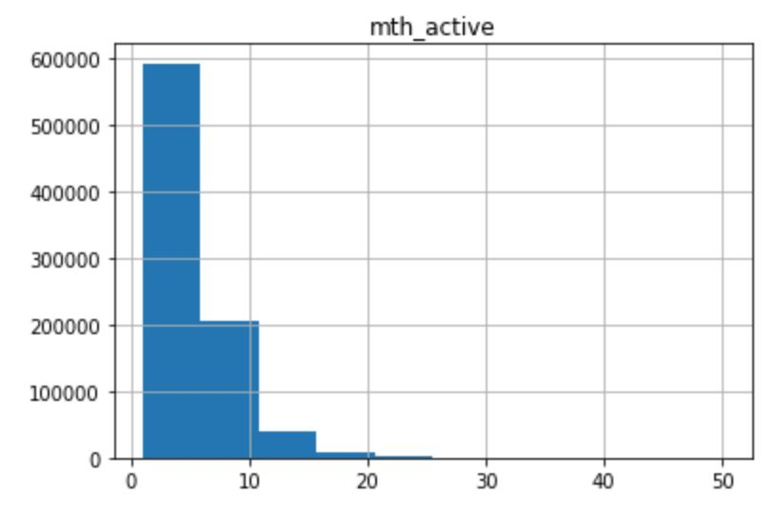

Additional Findings (i)
Offer one year contracts at discounted rates
Findings
The graph shows the distribution of how long members continued their gym subscription. We can see that the majority of participants, quit within the first 5 months and very few stayed beyond 10.
Suggestions/Limitations
The gym could update their pricing strategy to include a yearly contract at a cheaper rate. This will force customers to stay with the gym for an entire year.
‹#›

Slide 17
Additional Findings from Forecasting Tools
We explored and built a tool can predict on a per location basis. We also built a model that would forecast the number of people who would quit OC&Gym within the next 1 and 3 months.
Here we summarized the findings and their use cases respectively.
No | Findings | Use Cases
1 | within the next one month or three months, Kensington and Chelsea is expected to have the most customers churn , with Hammersmith being the second while Enfield is reported to have the lowest number of customers churn; | Helping the company to allocate resources objectively by focusing on programs to improve overall clubs’ performance at Kensington and Chelsea within the next one or three months
2 | approximately 34706 customers are predicted to churn within the next one month; | Helping the company to perform attractive programs that can arrest the churn within next one month.
3 | approximately 46989 customers are predicted to churn within the next three months; | Helping the company to perform attractive programs that can arrest the churn within next three months.
‹#›

Slide 18
Summary of Findings
Pricing Strategy
Firstly, to encourage members to stay longer, offer a 1 year subscription at a slightly lower cost since most leave within a year
Secondly, to remove the joining fee of 6 pounds on the standard membership , to encourage gym members to take which generally has a lower churn rate.
Other churn reduction tecniques
Groups of customers within your business that are more likely to churn than others - specifically females, flexible members and member older than 45 were more likely to churn. In addition, there was a significant loss of revenue. Considering that a lot of members leave gym due to either injury or loss of motivation we have provided specific advice on how to target these groups.
‹#›

Slide 19
Strengths/limitations
Strengths
We have almost explored most of the of the available attributes in the dataset, through many different forms of visualization and analysis.
Limitations
A key limitation of our analysis is that we did not look at the combined effect of factors. For example we explored gender and age brackets separately, but not females within a certain age bracket. For further analysis we could use data sets.
Data relating to the gym industry beyond London to see if we can target those areas
Data relating to surveys of customer experience at the gym
Data regarding quality of coaches/trainers at the gym
Data regarding size/capacity of gym and availability of gym equipment
Competitor data to compare the performance of the two businesses
‹#›

Slide 20
Thank you for listening, any questions?

